Slide 1
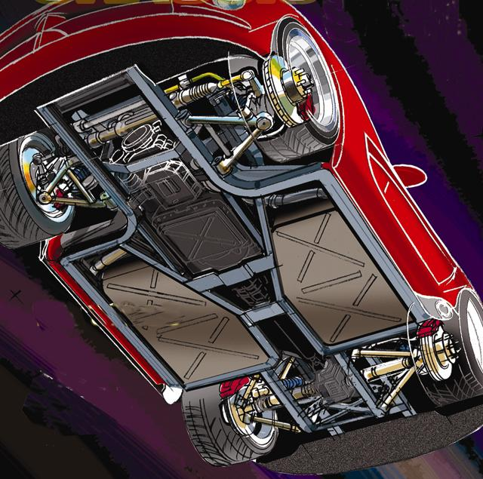
Auto 110 - Automotive Service
Under Car Service

Slide 2
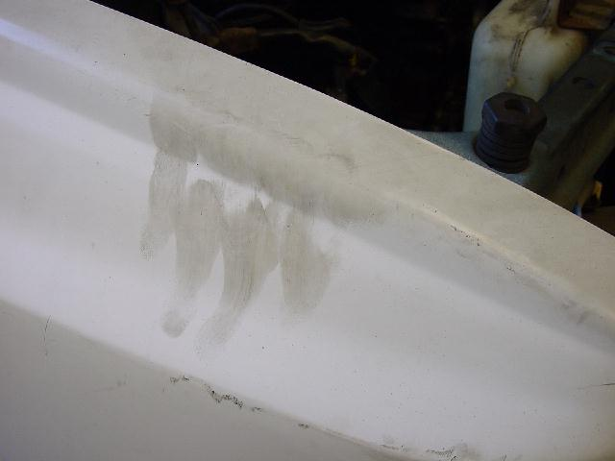
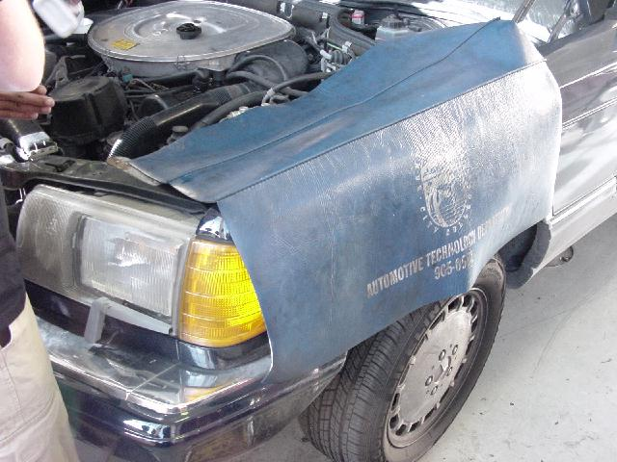
Reminder – Use Fender Covers!

Slide 3
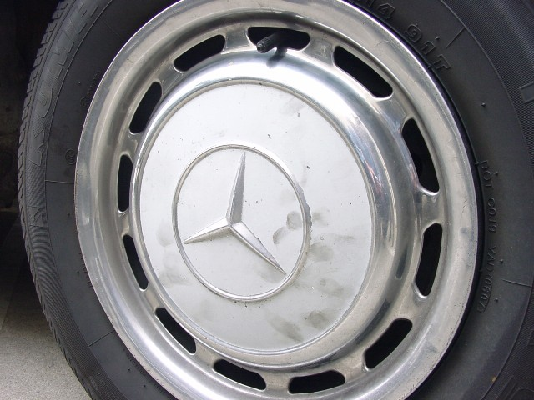
How would you feel if your car was returned like this?

Slide 4
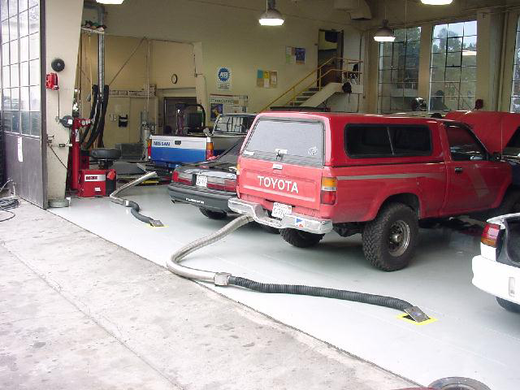
If you run an engine, use exhaust hoses.

Slide 5
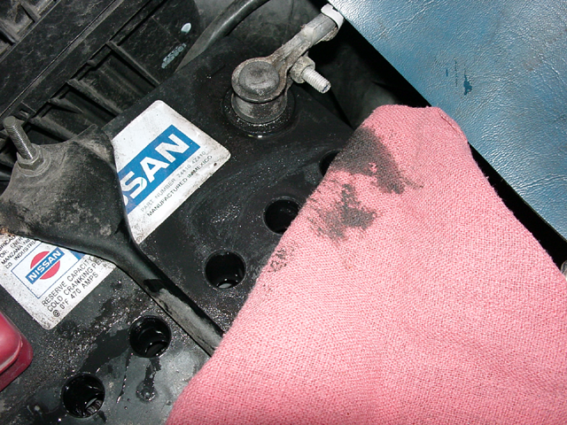
Do not clean a battery with a shop towel.

Slide 6
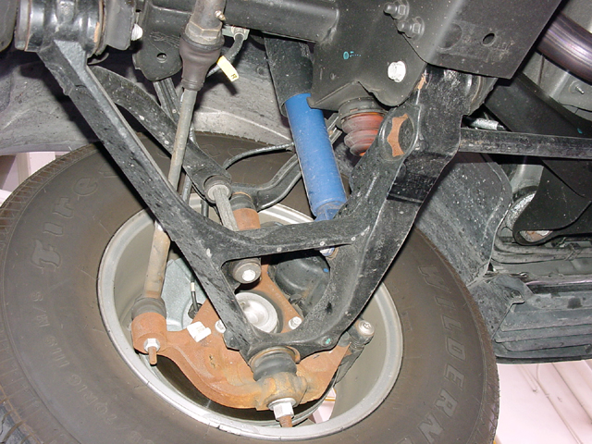
Shock absorber inspection

Slide 7
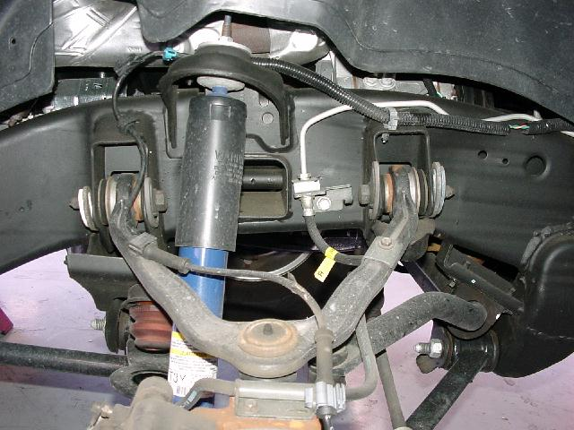

Slide 8
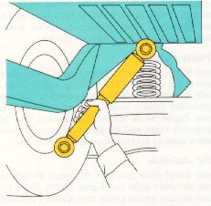
This test checks one stage only

Slide 9
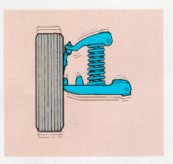
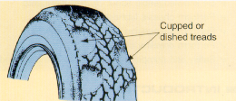
Scalloped or Gouged Wear
loose parts
wheel out of balance
bad shocks

Slide 10
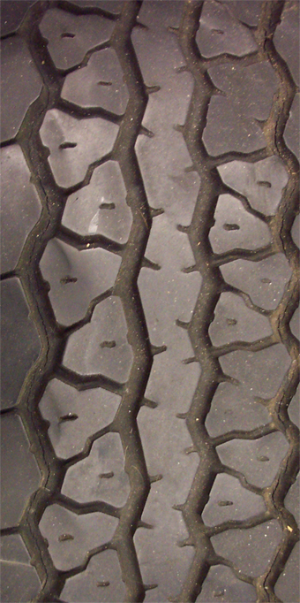

Slide 11
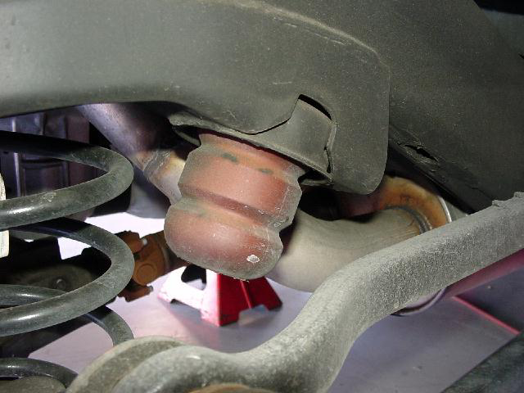
Shock failure - look for damage on rubber bump stops.

Slide 12
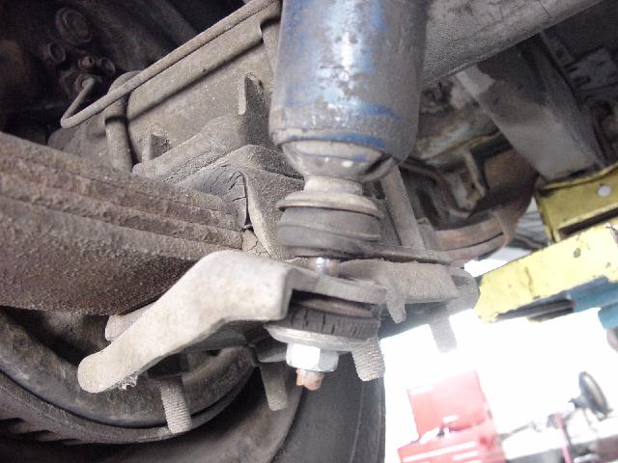
Loose shock mount

Slide 13
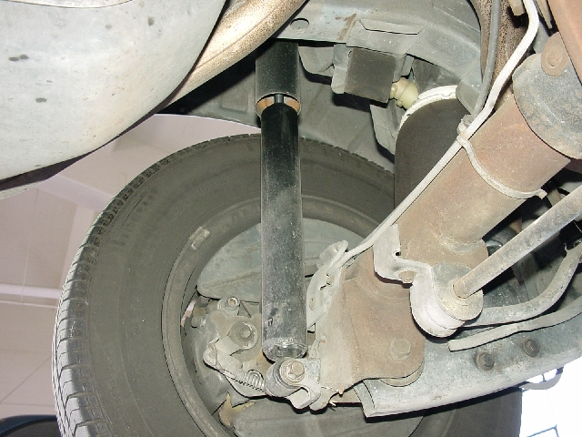
Slight moisture is normal

Slide 14
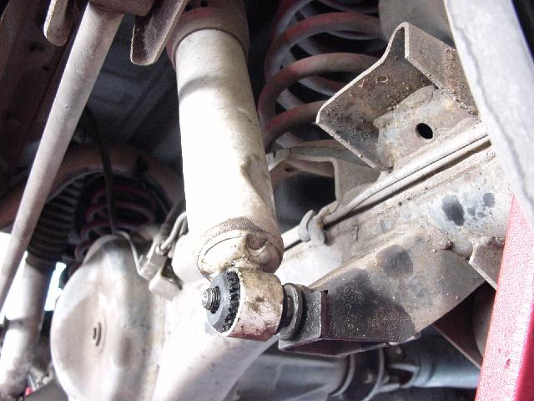
Damage is cause for replacement

Slide 15
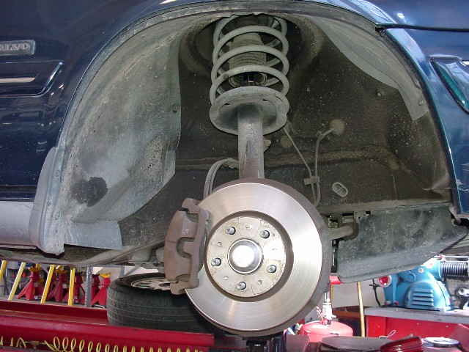
MacPherson Strut Suspension

Slide 16
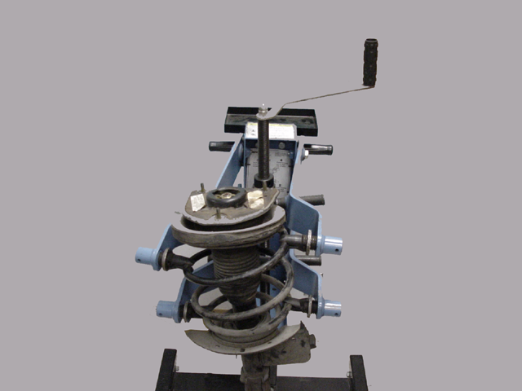
MacPherson strut shocks require more complicated service

Slide 17
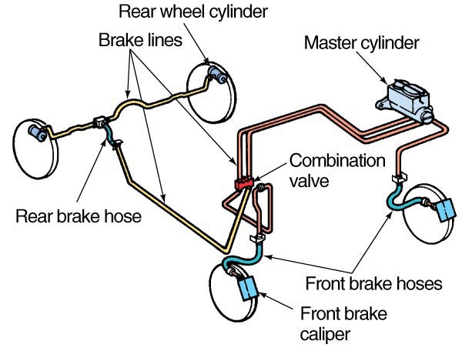
Inspect Brake Hoses - how many does the car have?

Slide 18
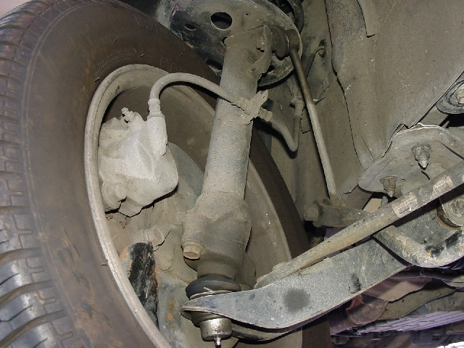
Each front wheel has a brake hose – allows wheel to turn

Slide 19
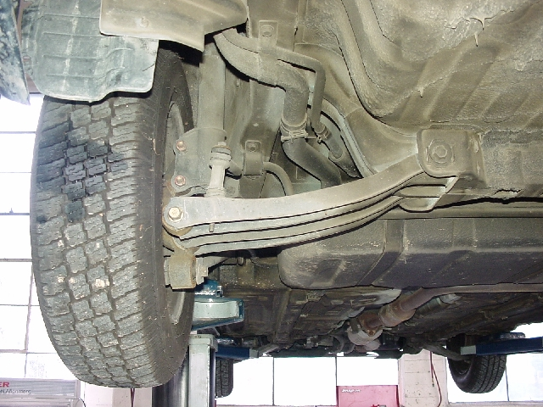
With independent rear suspension, there would be four hoses

Slide 20
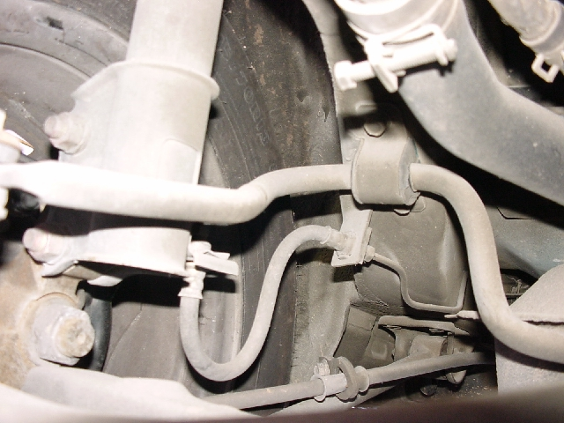
Rear Brake Hose
(independent rear suspension)

Slide 21
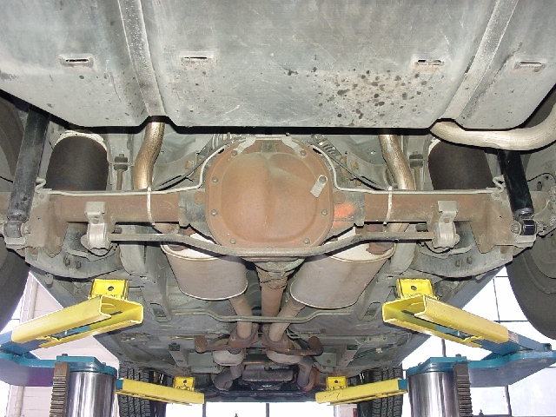
With a solid rear axle, there are often only three hoses.

Slide 22
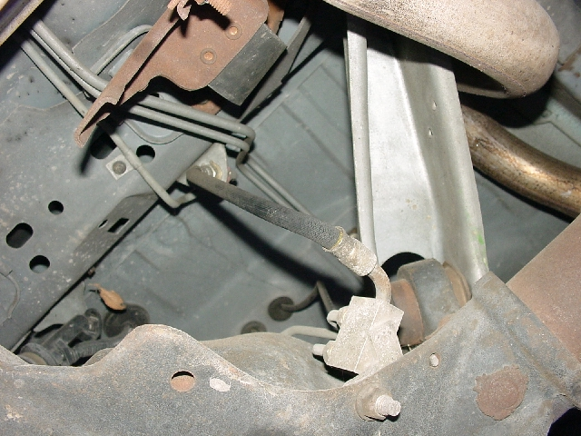
Hoses can deteriorate with age.
This one is a single hose above a solid rear axle.

Slide 23
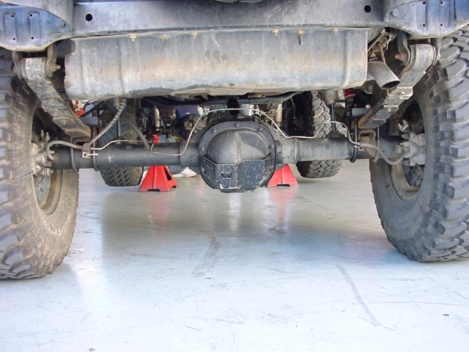
This solid axle has a hose at each side

Slide 24
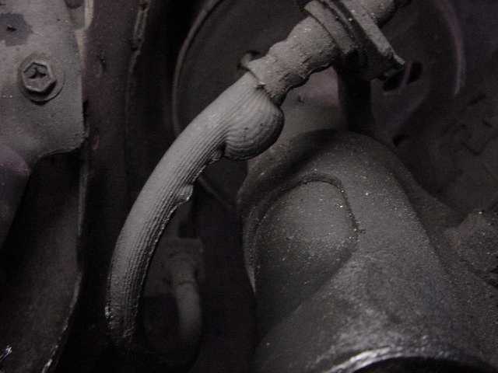

Slide 25
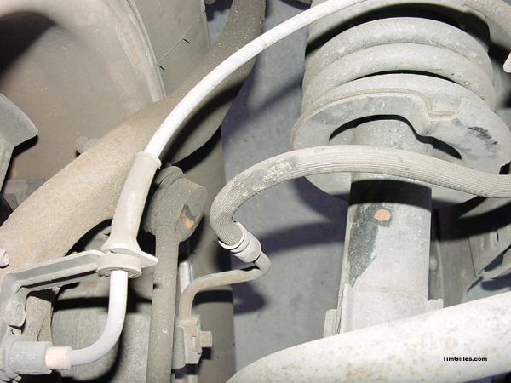
This hose has been rubbing

Slide 26
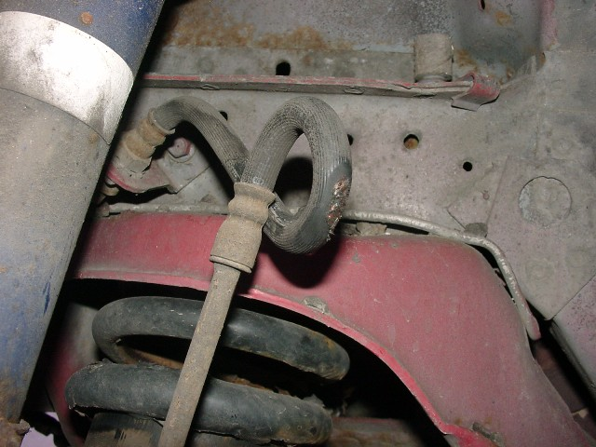

Slide 27
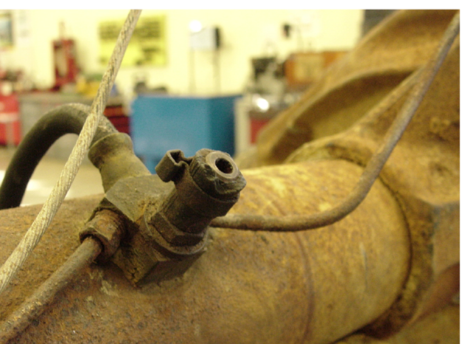
RWD: Check the differential vent hose

Slide 28
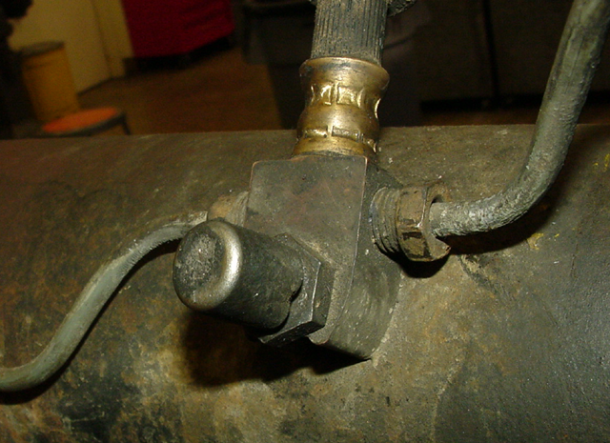
Some don’t have a hose

Slide 29
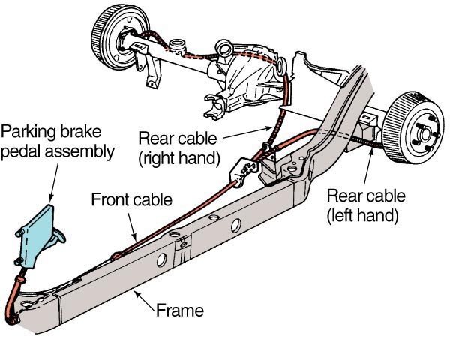
Emergency Brake Cable

Slide 30
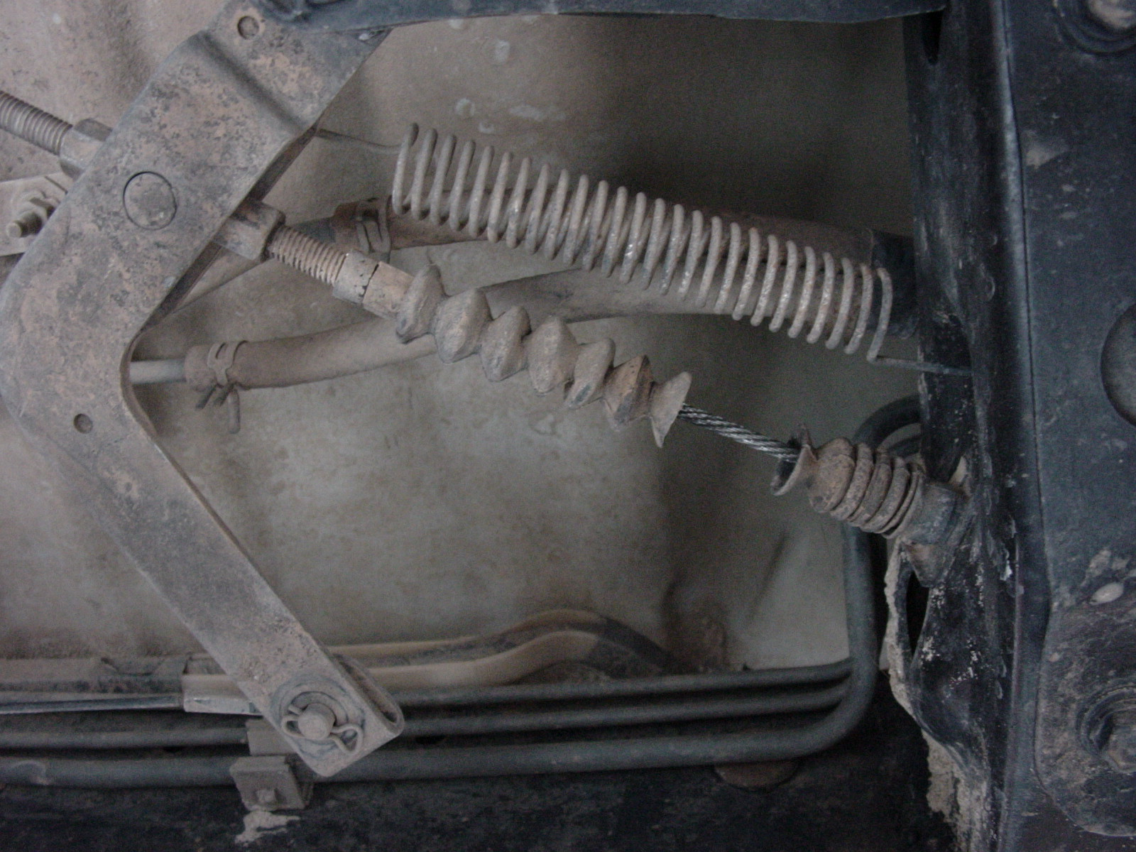
E-brake cable and linkage

Slide 31
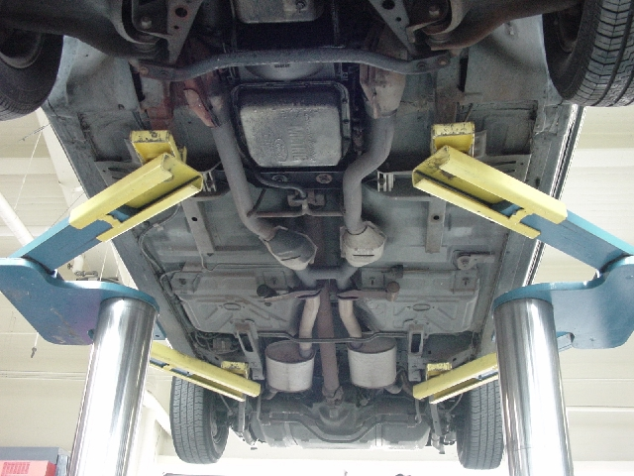
Exhaust System Leaks
Catalytic converters
mufflers

Slide 32
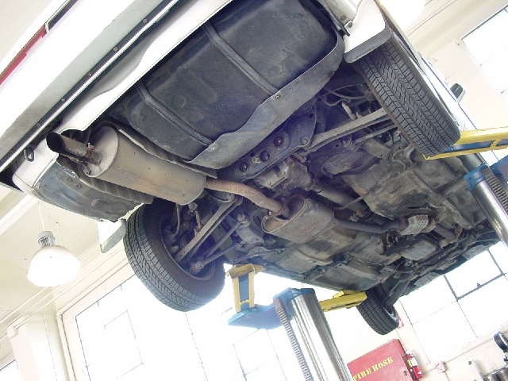
Single exhaust

Slide 33
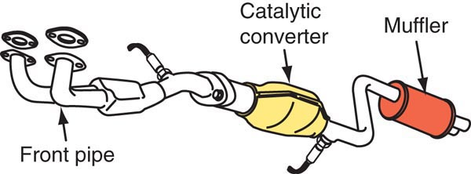

Slide 34
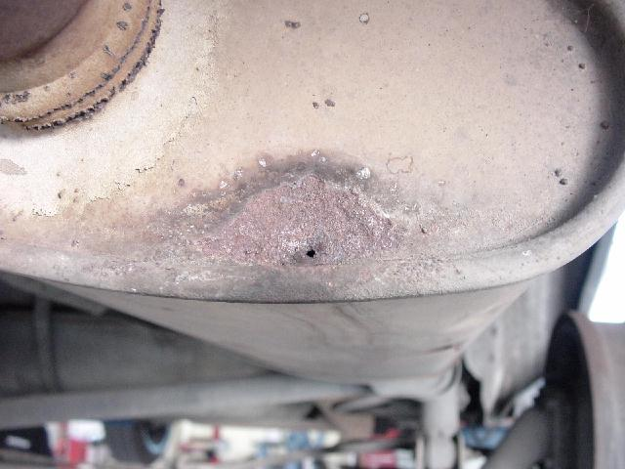
Where are exhaust leaks usually found?
On the bottom

Slide 35
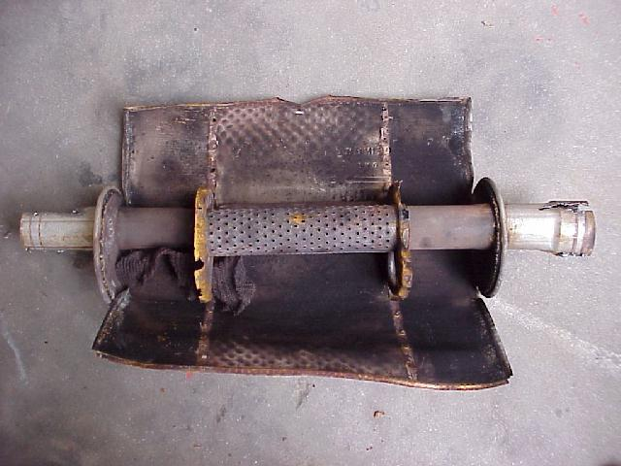
Too much fuel in the exhaust…

Slide 36
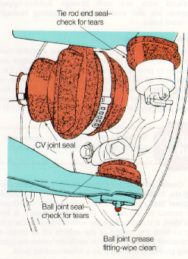
Rubber Boot Leaks and Damage

Slide 37
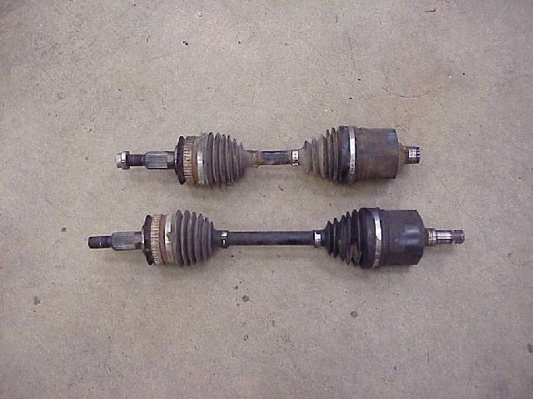
CV Axles

Slide 38
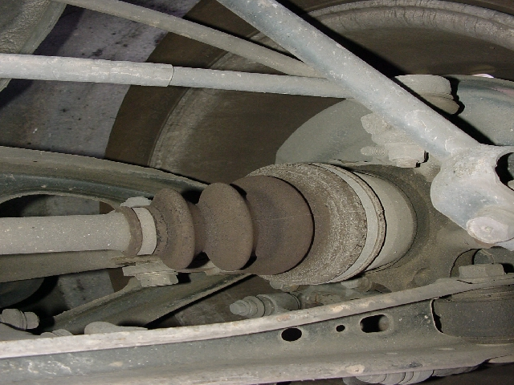
Inspect Rubber Boots

Slide 39
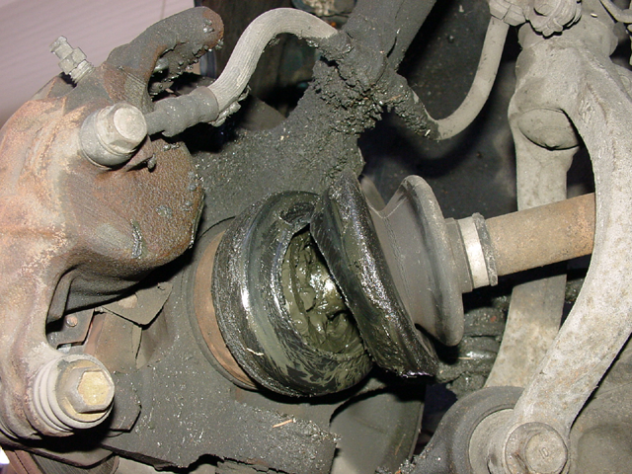
Why does the outer CV joint boot fail more often than the inner?
The outer boot is right next to the disk brake rotor so it gets hot.

Slide 40
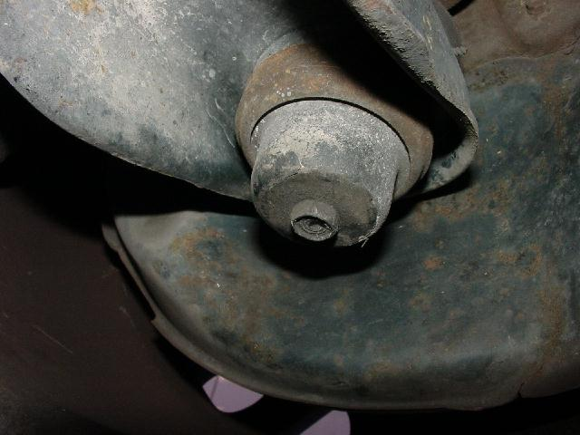
This plug can be replaced with a zerk fitting

Slide 41
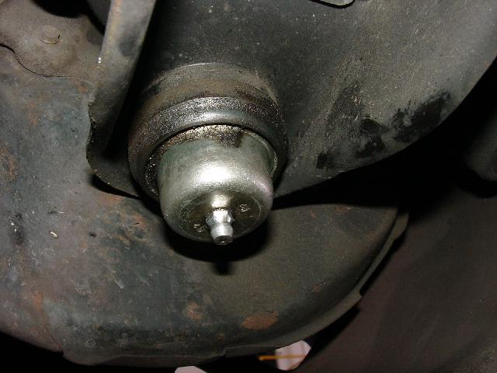

Slide 42
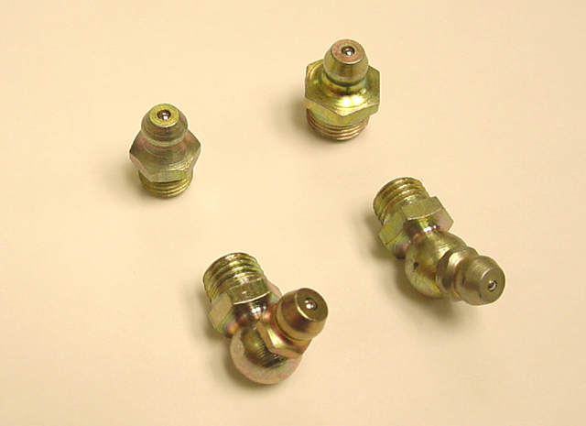
Zerk Fittings
Be sure to wipe off a fitting before applying grease.

Slide 43
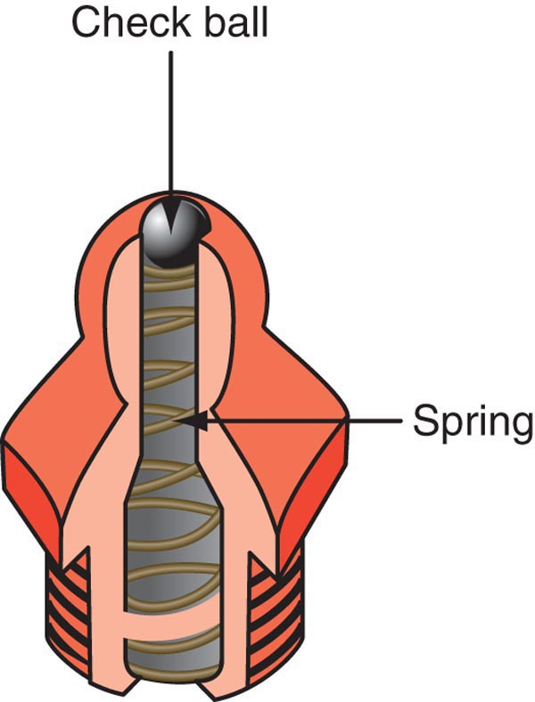

Slide 44
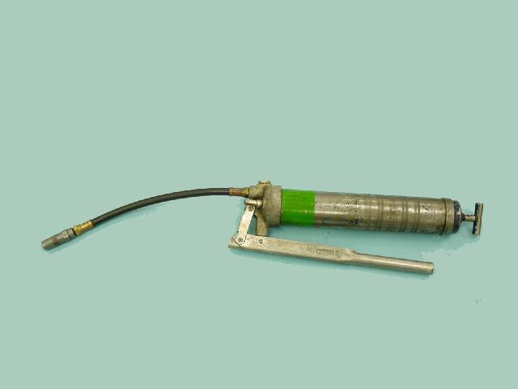
Hand Held Grease Gun

Slide 45
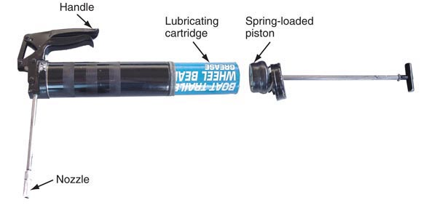

Slide 46
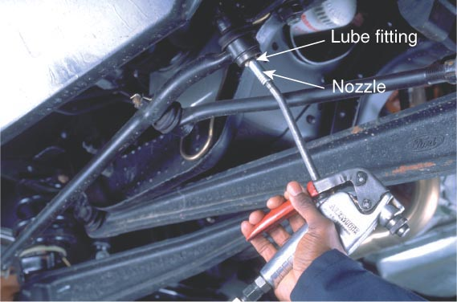
Grease Gun nozzle grips the fitting

Slide 47
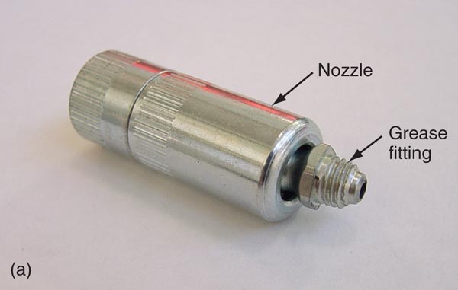

Slide 48
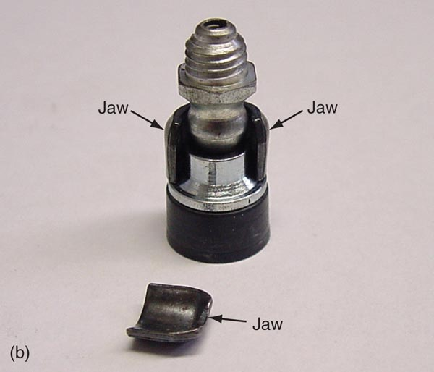

Slide 49

Fill until rubber bladder expands

Slide 50


Slide 51

Suspension and Steering Checks

Slide 52

Bushing inspection

Slide 53


Slide 54


Slide 55


Slide 56

Gear case fluid level checks

Slide 57


Slide 58

Filling gear cases

Slide 59

Manual transmission fluid level

Slide 60

Be sure you are loosening the correct plug.

Slide 61

Don’t loosen this on a Ford

Slide 62

differential fluid level

Slide 63


Slide 64

Inside a differential

Slide 65

Universal Joints

Slide 66


Slide 67

Checking U-joints

Slide 68

Damaged U-joint

Slide 69

Single universal joint

Slide 70

Double universal joint

Slide 71

Center support bearing

Slide 72

Don’t forget the door sticker

Slide 73

If you want to remove a serpentine belt to inspect it…

Slide 74


Slide 75


Slide 76
Break – 5 minutes

Slide 77

Tire inspection and service lab assignment

Slide 78


Checking Tire Pressures

Slide 79

Correct Tire Inflation

Slide 80

Over-inflation wear

Slide 81

Under-inflation Wear
Typical loss in tire air pressure is 2 pounds per month

Slide 82

Number of low tires per vehicle
Courtesy of Bridgestone

Slide 83

Tire Placard

Slide 84

Tread Wear Indicators
more than 2 rows of tread with wear bars showing means excessive wear

Slide 85

Wear bar indicator

Slide 86


Slide 87


Slide 88


Slide 89


Slide 90

Tire sidewall labels

Slide 91



Slide 92

Tire size

Slide 93

A light truck tire has an “LT”

Slide 94

A European tire has no “P”

Slide 95

Uniform Tire Quality Grade (UTQG)
Treadwear
Traction
Temperature

Slide 96

Traction Rating

Slide 97

Treadwear Rating

Slide 98

Better Treadwear

Slide 99

Temperature Rating

Slide 100
Check out some tire labels. Are the following tires good in all categories?

Slide 101


Slide 102


Slide 103


Slide 104


Slide 105

DOT number lists where a tire was made and which mfg. This is a Mohawk from Virginia

Slide 106

Another DOT code

Slide 107

Date code = 51st week of 2001

Slide 108

Load and speed rating

Slide 109

A tire’s load carrying ability depends on correct air pressure

Slide 110

A non-speed rated tire distorts
Courtesy of Bridgestone

Slide 111


Slide 112

A “snowflake on the mountain” symbol is on a snow tire

Slide 113

Snow tires have lower speed ratings and wear out fast

Slide 114


Slide 115


Slide 116

This tire rotates a certain direction only

Slide 117

Directional tire tread

Slide 118

Tire serial number – usually mounted to the inside

Slide 119
1) An under-inflated tire will wear a) On the outside edges of the tread b) In the center of the tread

Slide 120

Over or under?

Slide 121

Over or under?

Slide 122

Indentations = normal
Bulges = abnormal

Slide 123
2) When the tread bar is even with the surface of the tread, there is less than ________ of tread remaining a) 1/32” b) 1/16” c) 1/8”

Slide 124


Slide 125

Cheater Slicks – Why?

Slide 126
3) Check tire pressures when the tires are a) Hot b) Cold

Slide 127

This pin is for removing air

Slide 128

The top side of this tire chuck can be used on inner duals, too

Slide 129


Slide 130
4) The tire pressure specification is located a) On the driver’s door b) In the glove compartment c) In the owner’s manual d) Any of the above

Slide 131

5) Camber results in wear a) On the outside or inside of the tire b) Evenly on the entire tread

Slide 132

6) Toe wear results in a feathered edge wear on the entire tread. True or False?

Slide 133
Cupped wear can result from
a) Loose parts
b) Tires out of balance
c) Both a and b

Slide 134


Slide 135
8) What is a dry park check?

Slide 136
9) Which of the following are types of steering gears? a) Rack and pinion b) Recirculating ball and nut c) Both a and b

Slide 137


Slide 138


Remember: An “A” or a “V” - Face lift pads away from each other or toward each other, but not facing the same direction

Slide 139

Don’t forget the key for the wheel locks

