Slide 1
Automotive Service Lifting and Safety

Slide 2
Hydraulic Jacks
10 ton
2 ton
1 1/2 ton
Notes:
Compare the number of strokes needed to move the fluid. A 10 ton jack requires more strokes than a 2 ton jack.

Slide 3
Notes:
Describe how a jack works. See Automotive Service 4E

Slide 4
Bottle jack
Notes:
Add photo here

Slide 5
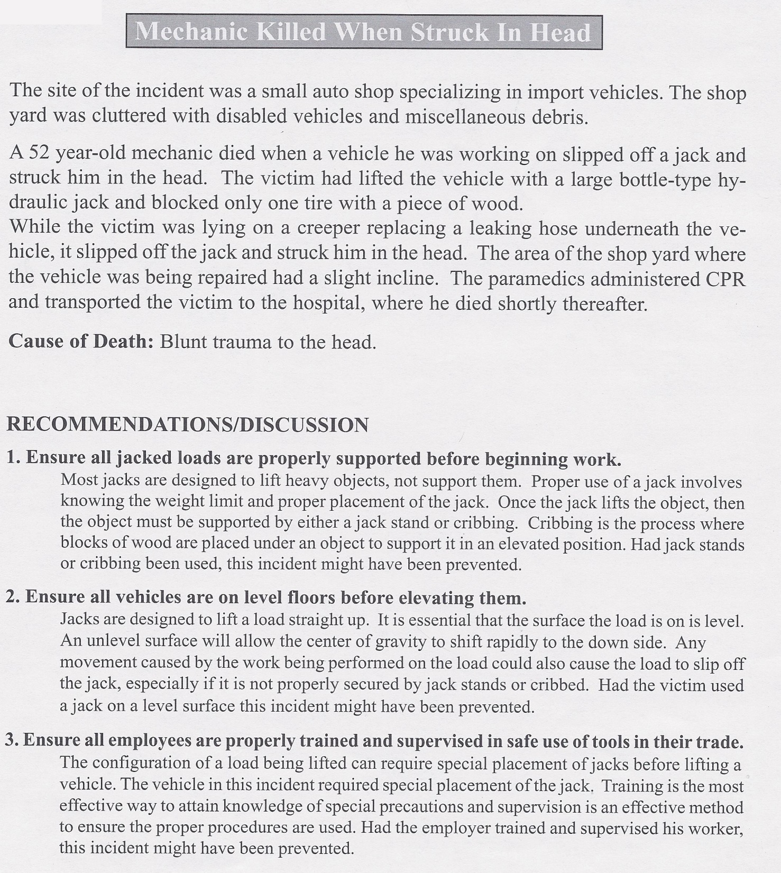
Bottle jack accident

Slide 7
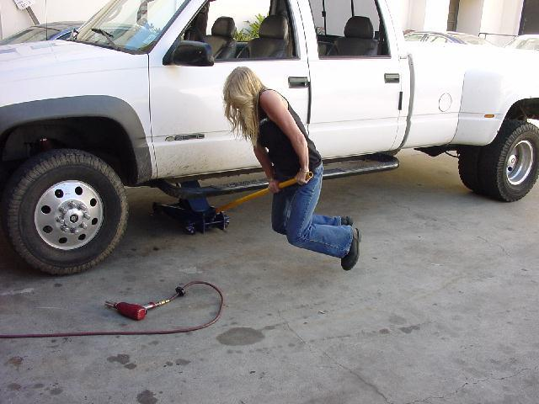
Use the right capacity jack!

Slide 8
Notes:
A handy quick-reference

Slide 9
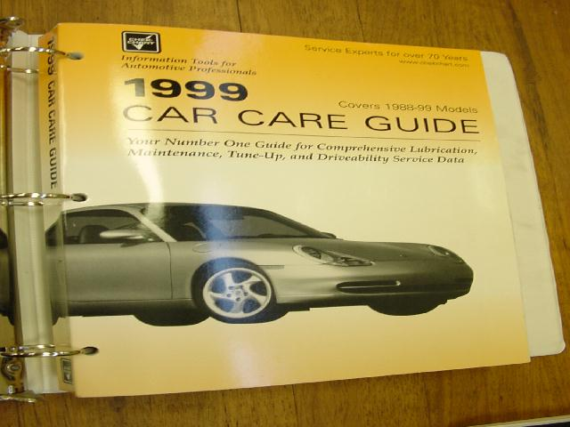
10 year coverage

Slide 10
Lift points

Slide 11
Notes:
Lift contact points

Slide 12
Finding lift points in AllData
maintenance tab
vehicle lifting

Slide 13
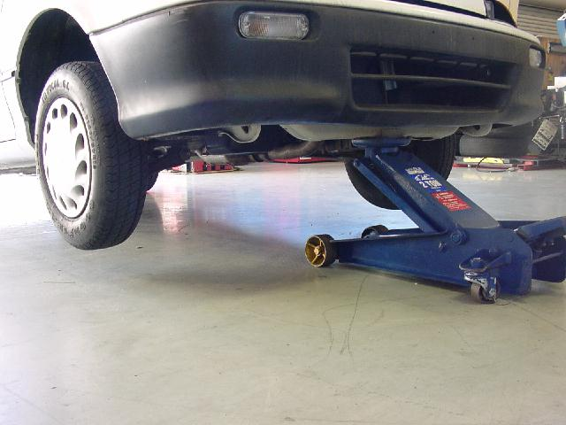

Slide 14
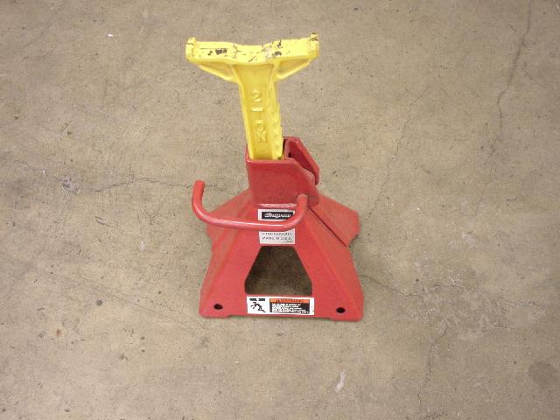
Jack Stands (Safety Stands)

Slide 15
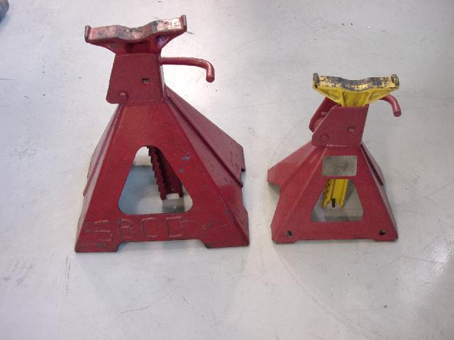
Use the largest jack stand that fits

Slide 16
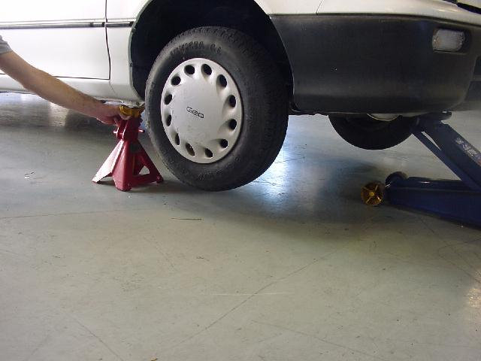

Slide 17
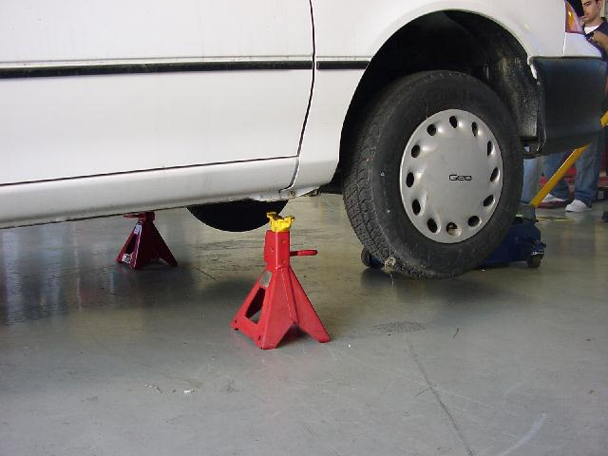
Position the handle facing out

Slide 18
Leave the handle up so no one trips on it

Slide 19
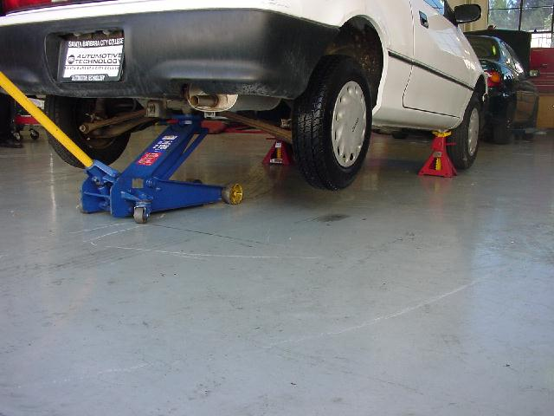
After the front stands are positioned: Lift the back

Slide 20
Lift in a solid place in the center

Slide 21
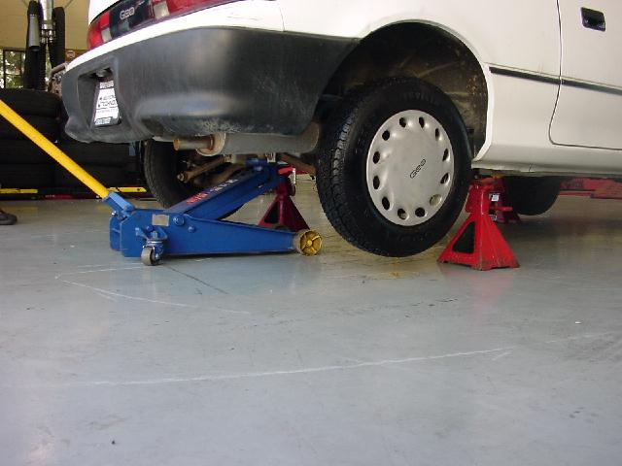

Slide 23
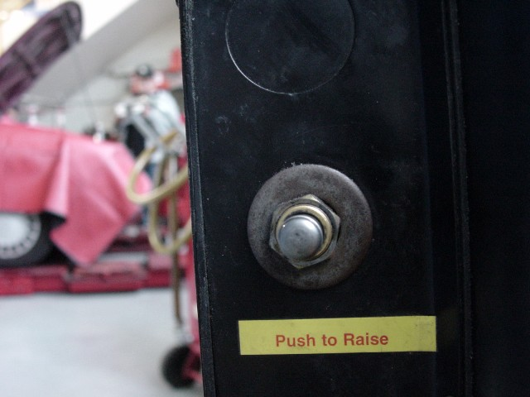
Notes:
These are instructions to our lifts. Shoot your own photos of your lifts and I insert them here.

Slide 24
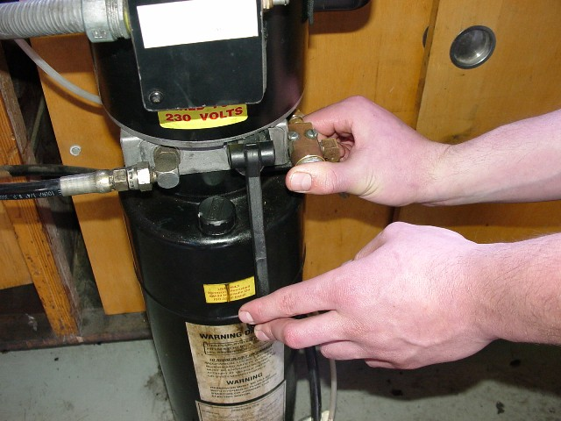
Hold release button to lower

Slide 26
Let out the air first

Slide 27
Check before lowering a vehicle
Notes:
I tell a story here about how a shop owner lowered a vehicle onto a technician’s tool box. Expensive!

Slide 28
Lift Arms - flip up to compensate for differences in frame height

Slide 29
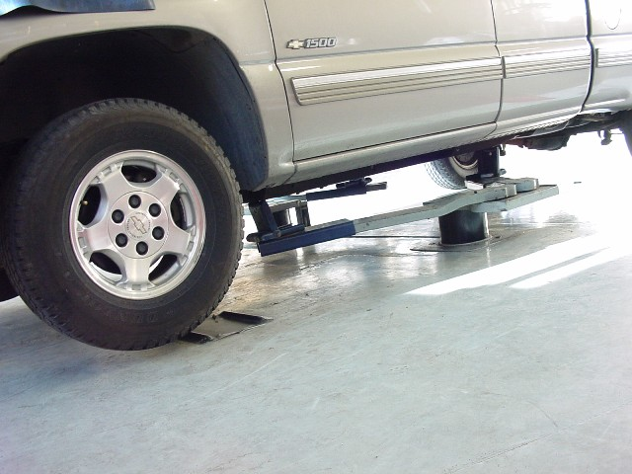

Slide 30
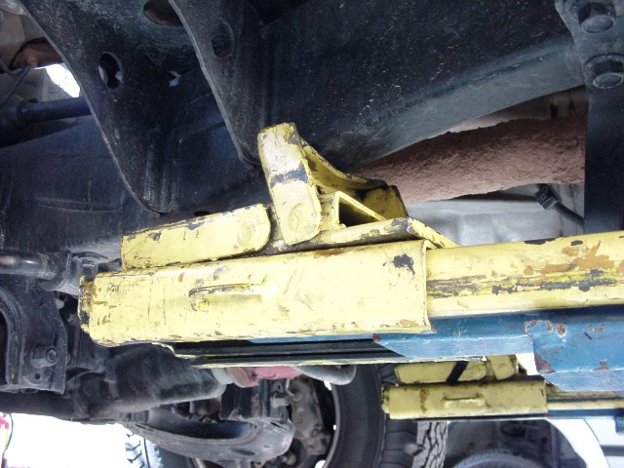

Slide 31
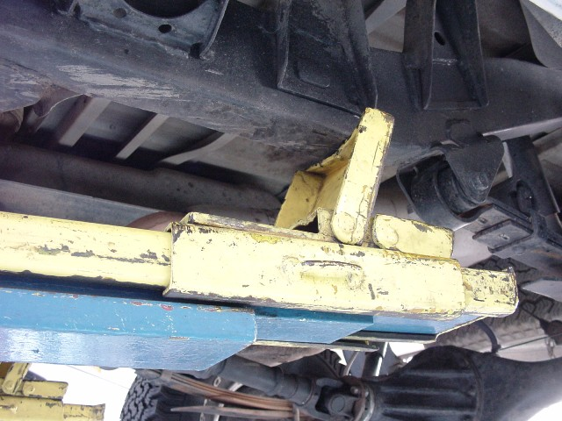

Slide 32
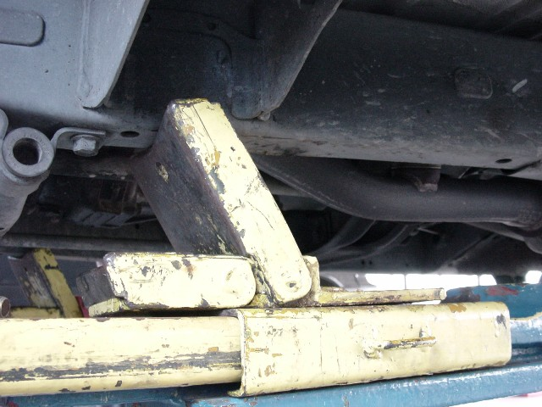
Vary the direction as needed

Slide 33
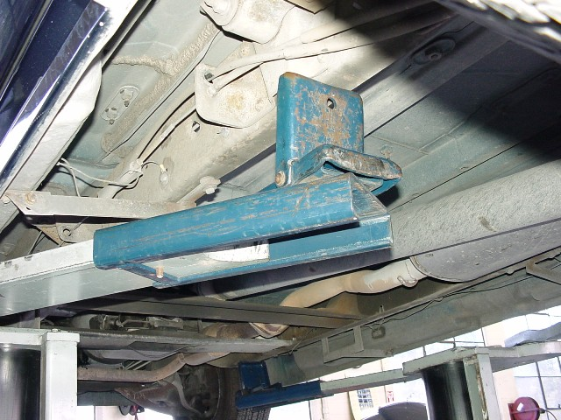
Notes:
There is a pin here that prevents the lift pad from sliding too far out.

Slide 34
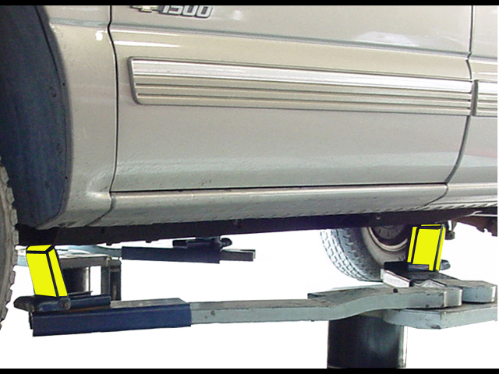
“V” or “A”
Notes:
But not parallel

Slide 35
Center of gravity is wrong
Notes:
Dangerous. Push on the bumpers and listen. If the lift pad is coming away from the frame contact, this is dangerous.

Slide 36
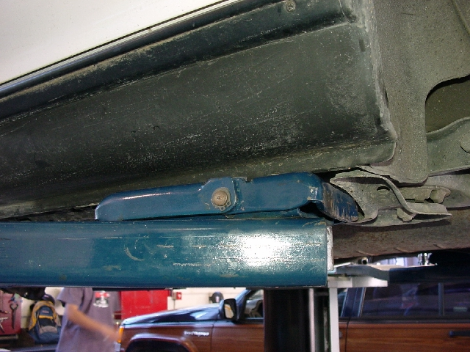
Lifting many unibody cars
Notes:
Look for the place where the mfg designed the bumper jack to go.

Slide 37
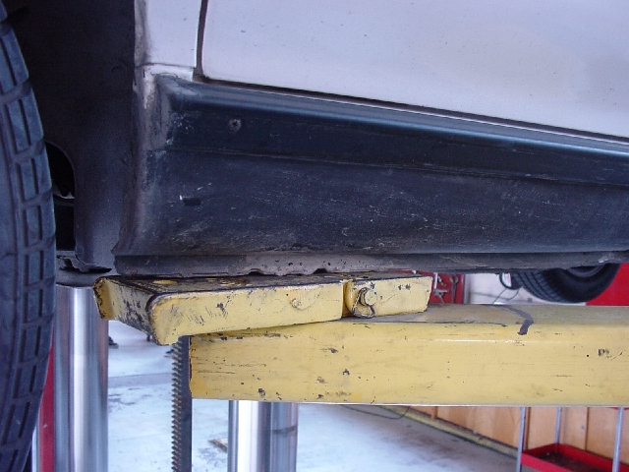
Notes:
The wrinkled area in the center is where the bumper jack is supposed to attach.

Slide 38
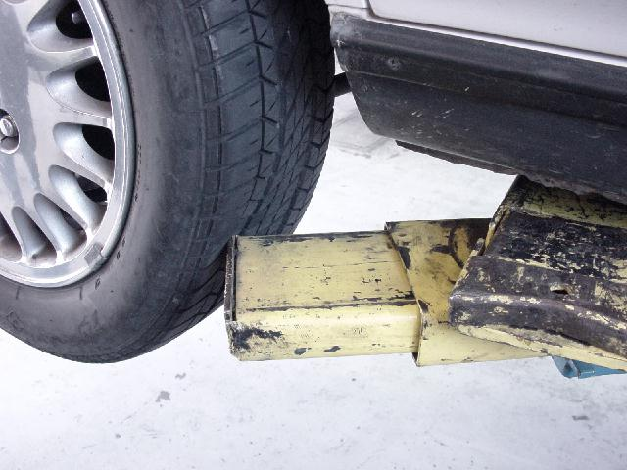
Don’t ruin a tire!
Notes:
This is a steel belted tire that had to be replaced, as well as the one on the other side. Tires are replace in pairs.

Slide 39
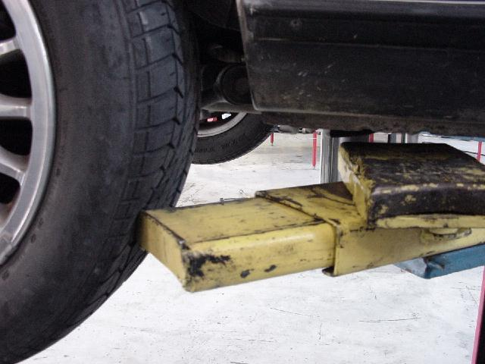
Notes:
Note the lift pad away from the vehicle.

Slide 40
Notes:
Find truck falling off lift video on the internet

Slide 41
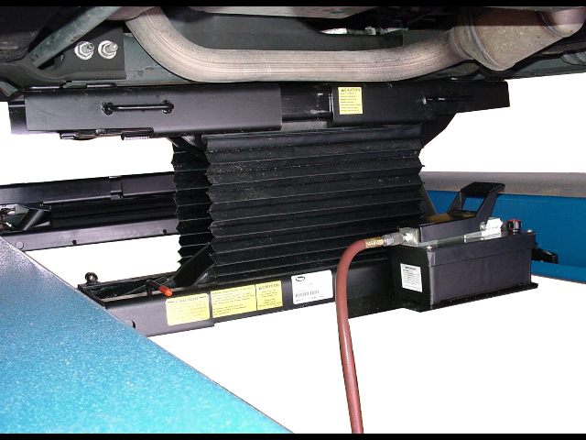
Moveable air jack on wheel contact lift

Slide 42
Air hose connection
Notes:
Shoot your own photo to match your shop equipment

Slide 43
Not for tightening wheel lugs
Notes:
This can be used on low pressure setting to seat the lugs, but a torque wrench is used for tightening. I do not show tork sticks at this time.

Slide 44
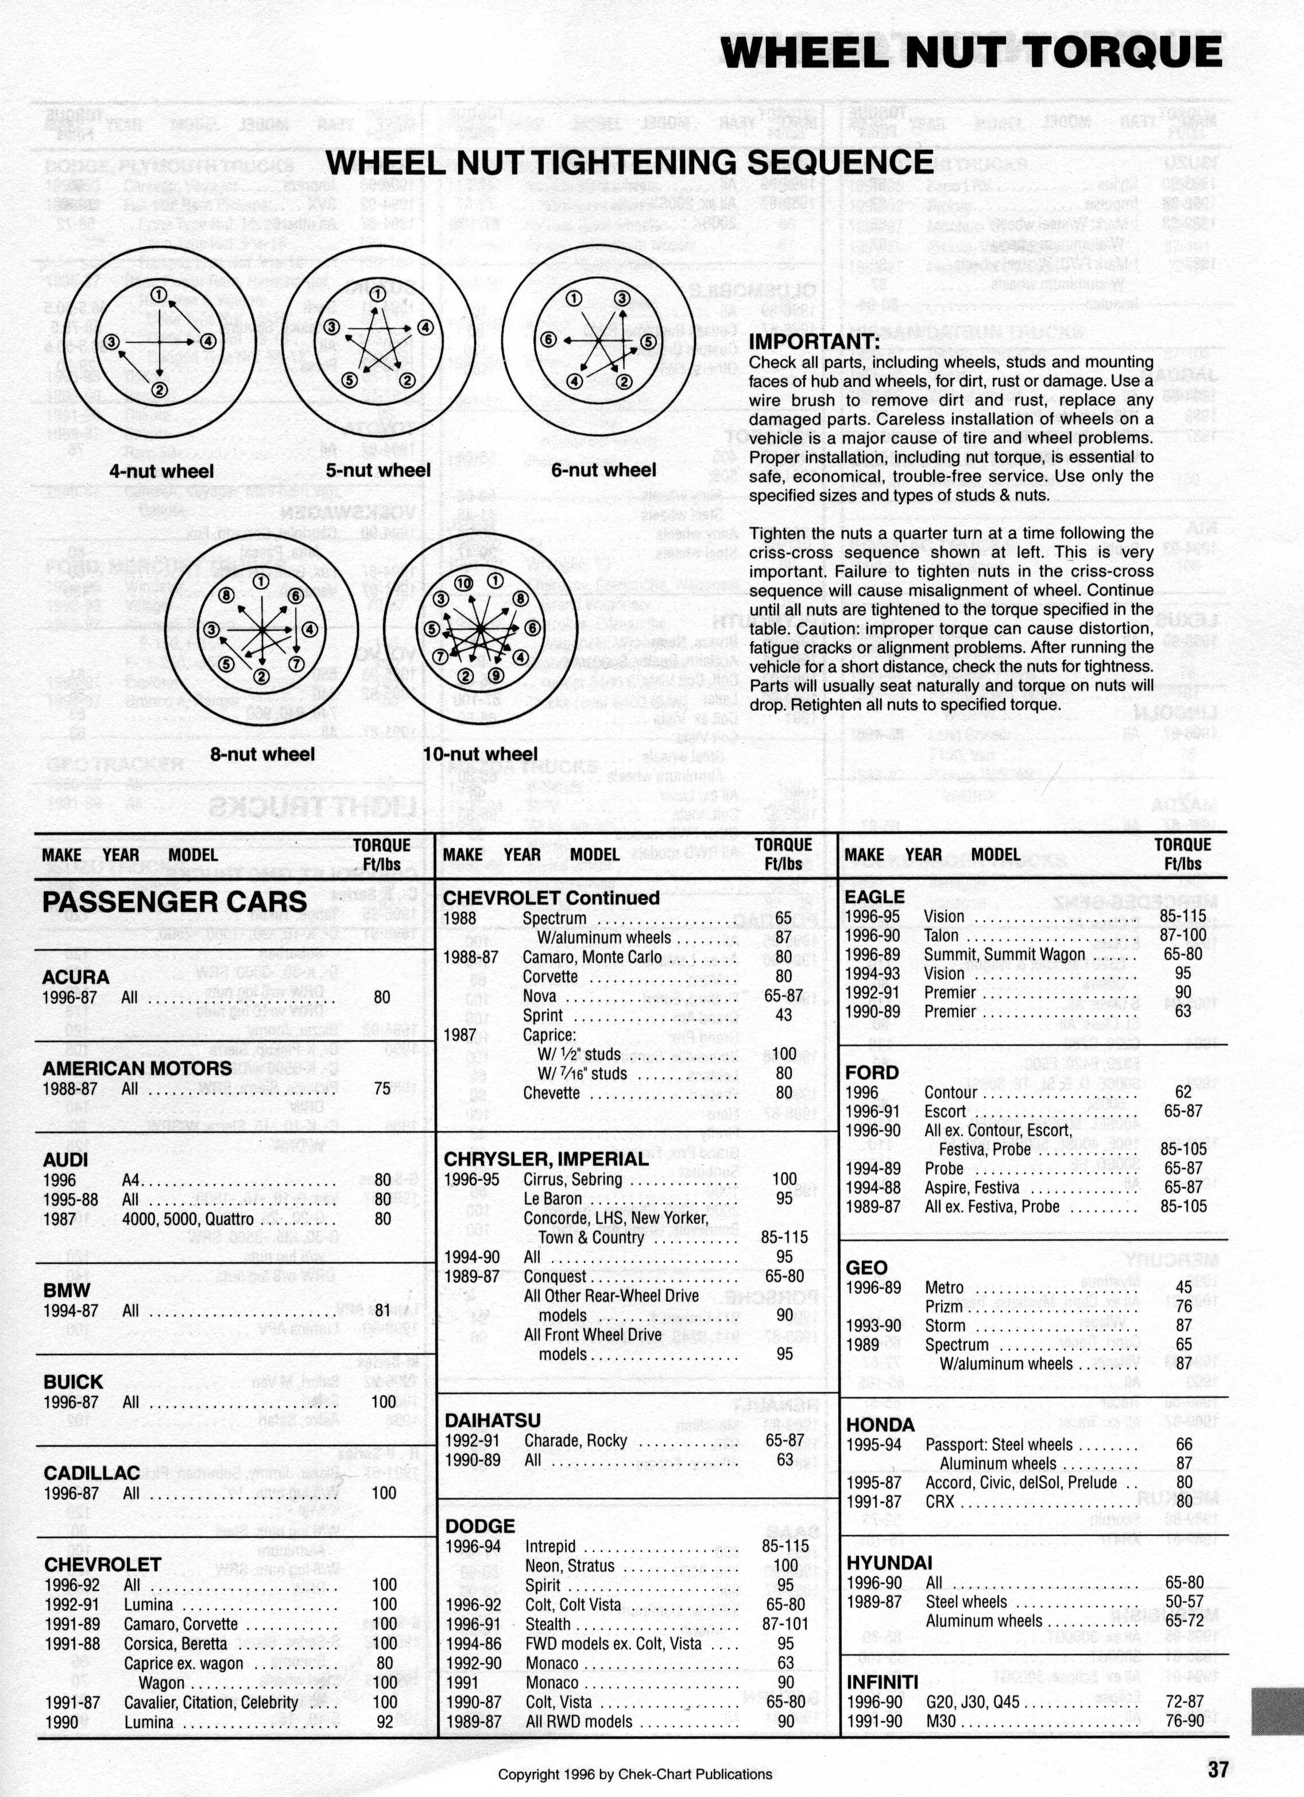
Wheel Nut Torque
Check specification in Car Care Guide
Notes:
This would have been a good scan if a sheet of black paper had been positioned behind the page during the scan.

Slide 45
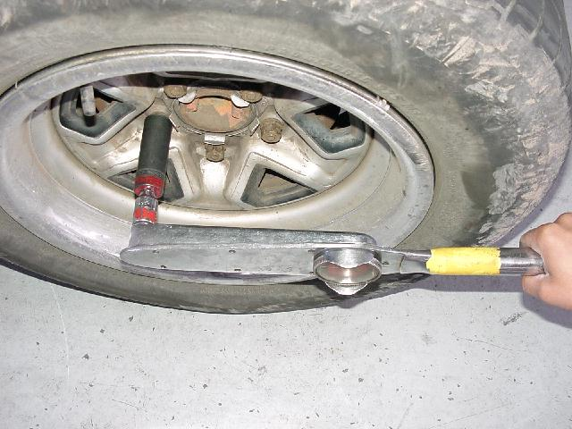
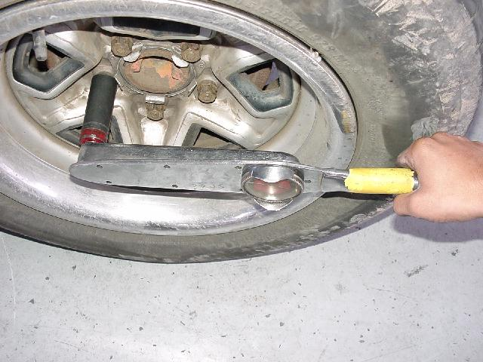
Which is right?
Notes:
Use an extension to provide clearance if necessary.

Slide 46
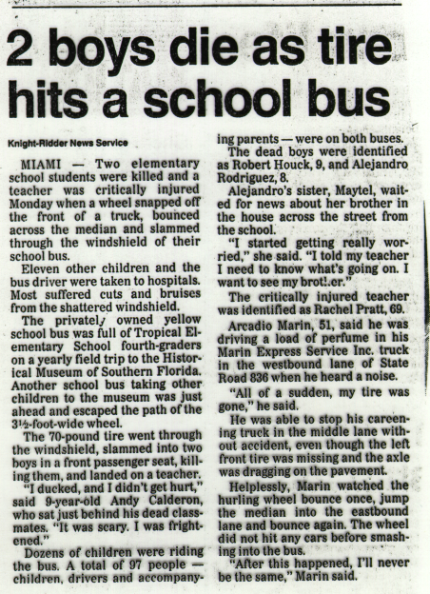
Notes:
Someone did not torque correctly.

Slide 47
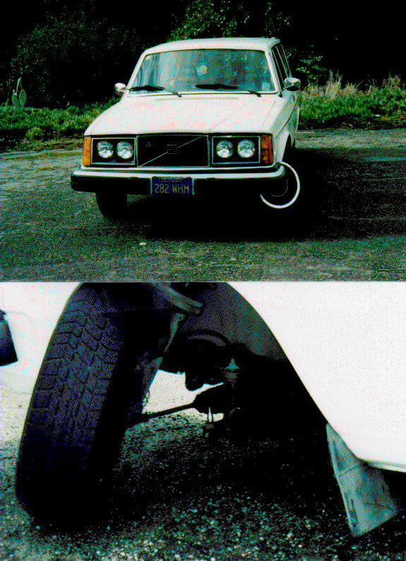
Someone did not torque the ball joint correctly. This was very dangerous!
Notes:
This car was driven on the freeway for several miles before this happened. VERY lucky!

Slide 48
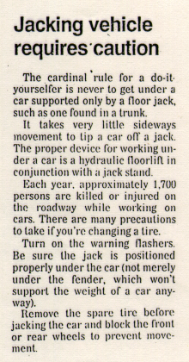
Notes:
Bumper jacks are bad news!

Slide 49
Notes:
Bumper jack accident

Slide 50
Notes:
He used a cinder block. Use plywood squares. The laminations prevent failure.

